Slide 1

PREDICTING CREDIT CARD ATTRITION
Bank of Hartford
Group 5

Slide 2
AGENDA
Background and Business Problem Who are we addressing and what are we trying to solve?
Building predictive models and results What models did we build? How did we approach and what were our results?
Deriving Business Insights What did we observe and how do we explain it?
Recommendations and call for action What should be done next and what do we propose?

Slide 3
BANK OF HARTFORD
Background
Bank of Hartford (BoH) is a financial institution headquartered in Hartford since 1972.
BoH offers personal and business banking services including credit cards, investment banking and personal loans
BoH has a total of 45,000 personal banking customers as of 2021 and 22.5% of customers use their credit card services.
Business Problem
Increase in credit card customer churn since the pandemic was observed.
Revenue generated through credit card has decreased significantly putting BoH in back foot compared to their competitors.
Lesser visibility into reason(s) behind customer churn

Slide 4
OBJECTIVES
Identify influencing factors for credit card customer churn
Build a classification model(s) to classify customers into churn buckets. Choose the most appropriate model to be integrated with Bank of Hartford
Determine the period in months after which a customer is expected to churn
Devise recommendations for Bank of Hartford to better target customers,market their services and increase credit card adoption and usage.
Identify any bias in credit card services that needs to be addressed.

Slide 5


DATASET - A SNAPSHOT
$ 8,632
46
47%
53%
Average Credit Limit
Average Age
$44 M
<$40k
Married
2 / 3 dependents
Total Transaction Amount
Common income category
Marital Status
Source: Credit Card Customer Churn Prediction | Kaggle (10,127 rows), Google Image | Shutterstock

Slide 6
ATTRITED CUSTOMER - A SNAPSHOT
3
2.69
45
Average contact count
(12 months period)
Average Inactive count
(12 months period)
Average total transaction count
16.06%
Attrited customers in the dataset
3.2
$3k
Average Relationship Count
( Products held by the customer)
Average total transaction amount

Slide 7
MODELLING
Target Variable: Attrition Flag
Data Split: 60% training, 40% validation
Predictor Variables: 16 continuous variables, 2 ordinal and 3 nominal variables.
Model | RSqaure | RASE | Misclassification Rate
Nominal Logistic | 0.4675 | 0.2619 | 9.4%
Decision Tree | 0.6122 | 0.2192 | 6.1%
Bootstrap Forest | 0.7425 | 0.1773 | 4.1%
Boosted Tree | 0.7329 | 0.1803 | 4.4%
Neural Network | 0.6706 | 0.2033 | 5.7%

Slide 8
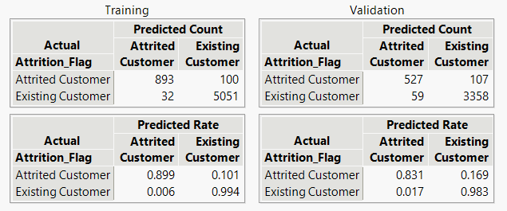
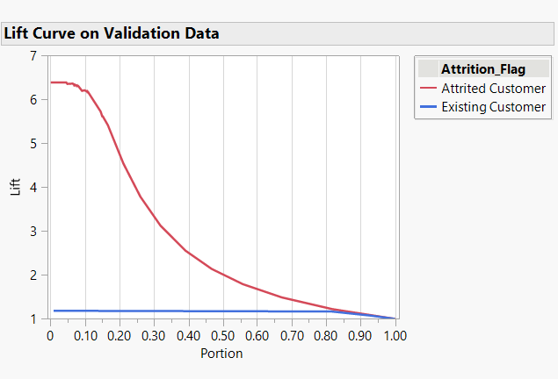
BOOTSTRAP FOREST
Bootstrap Forest is a method that creates multiple decision trees and in effect averages them all to determine the final predictive value.
Contributing Columns (Top 5): Total Transaction count, Total Transaction Amount, Total Revolving Balance, Total count Q4 to Q1, Total Relationship Count.

Slide 9
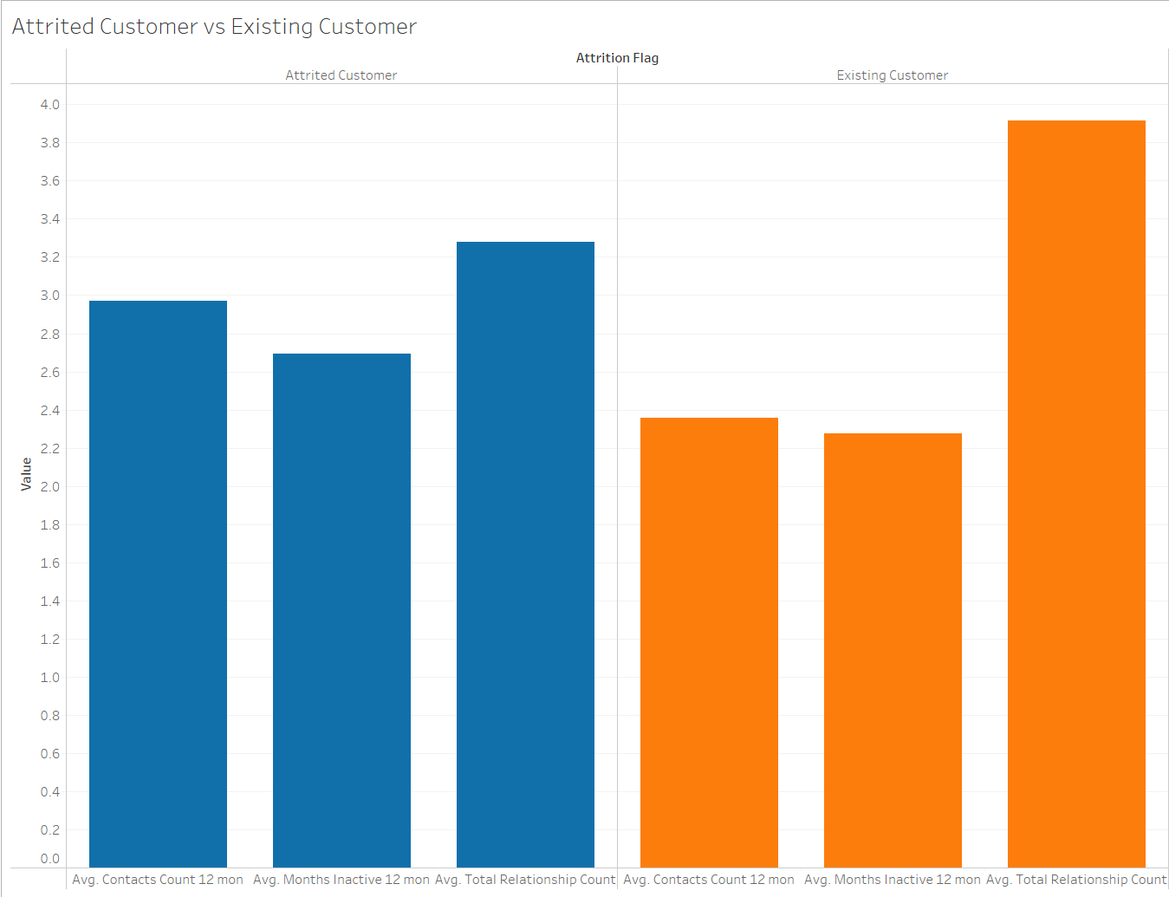
ATTRITED CUSTOMER VS EXISTING CUSTOMER - I
Average contacts count, inactive months count and relationship count vs Customer Status

Slide 10
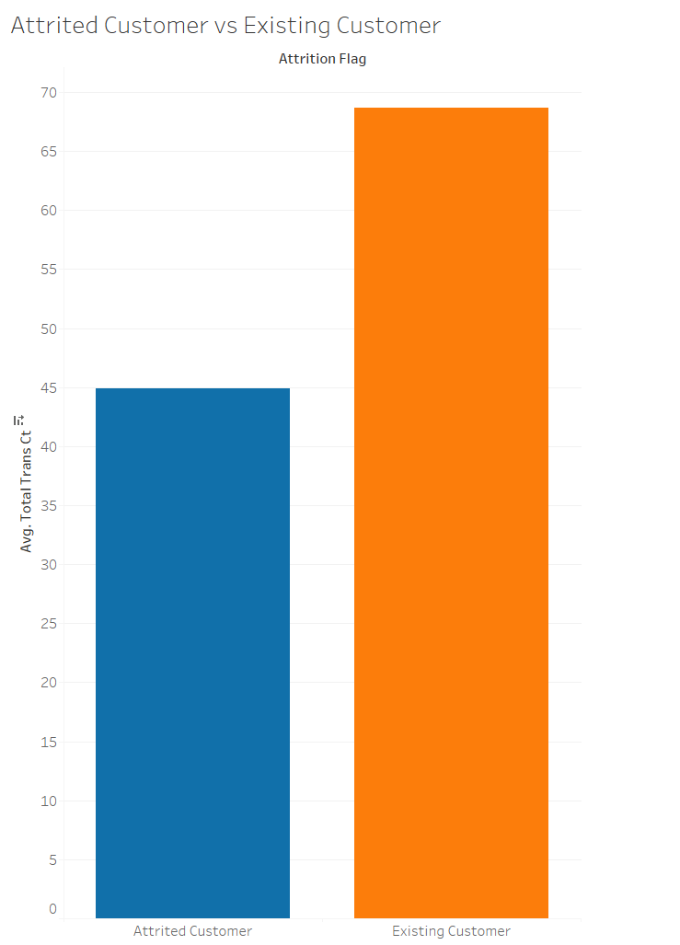
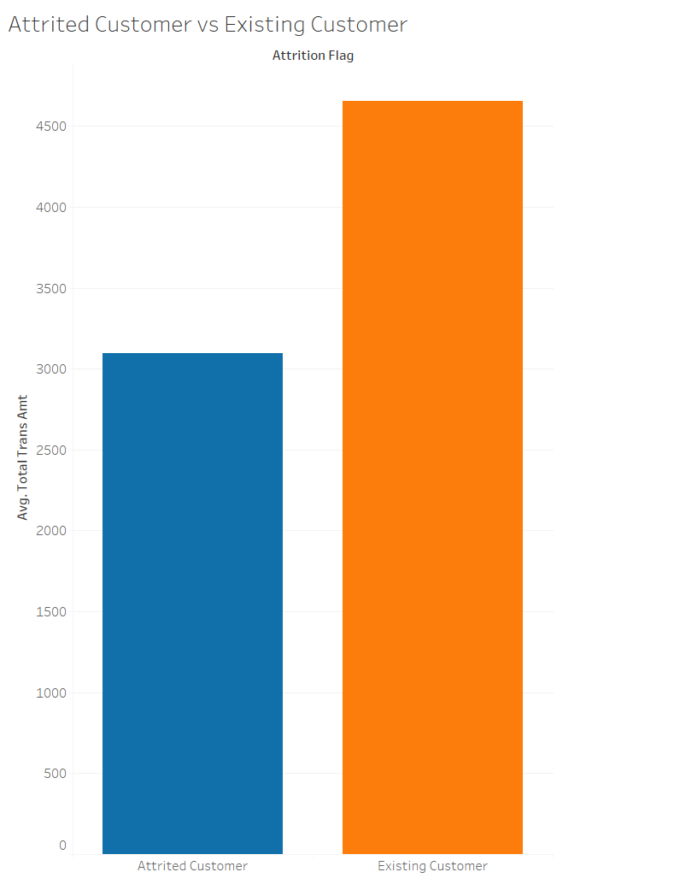
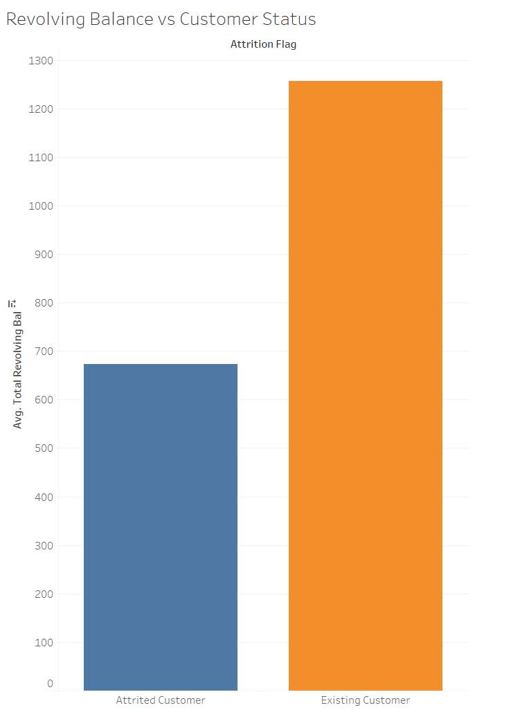
ATTRITED CUSTOMER VS EXISTING CUSTOMER - II
Customer status
vs
Avg. Total Transaction Amount
Customer status
vs
Avg. Revolving Balance
Customer status
vs
Avg. Total Transaction Count

Slide 11
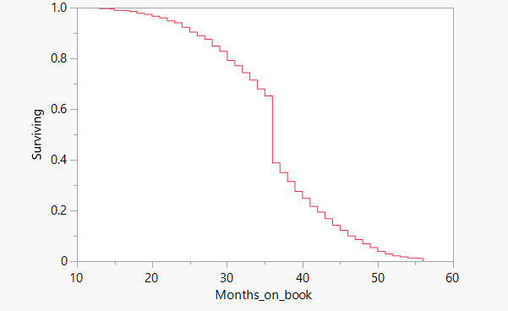
PERIOD OF RELATIONSHIP BEFORE CHURN - SURVIVAL ANALYTICS
To identify the break-off point of a customer by calculating chances of survival with months on book
30% decrease in chance of survival when the months on book reaches 36 months
Factors that increase the risk of survival (Top 4): Number of dependents, Count of contacts in the last 12 months, Credit Limit, Total Transaction Amount

Slide 12
RECOMMENDATIONS
Reduce the number of service contacts made my customers by
Transparent terms and conditions with intuitive mobile app
Promoting self-help using bots
Dedicated customer service team for high-risk customers
Promote cashback and discount offers to increase the transaction count and transaction amount
Cross-sell products and services to increase the relationship count
Run marketing campaigns to target customers after 24 months, 36 months and 48 months and evaluate customer usage health
Increase the credit limit of Female customers. The average credit limit for Female is 86% lesser than Male resulting in increased churn among Female customers

Slide 13
Q and A
Note from the team: Bank of Hartford is a fictitious name used only for demonstrative purposes

Slide 14
THE TEAM
GROUP 5
Adithya K R
Anisha Biswal
Yin Yue
Yun-Ting Yuan

